Slide 1


Navigating COVID-19 Data with Python
Welcome to our deep dive into the COVID-19 dataset. We'll explore practical data analysis techniques using Python and Pandas. This session aims to equip aspiring data scientists with essential skills for handling real-world data challenges.
by abhijeet kuanr

Slide 2

Dataset Overview and Preparation
1
Data Source
2
Real-World Context
We're using a small COVID-19 dataset for demonstration. It's sourced from Kaggle and accurate up to April 29, 2020.
While our dataset is small, the original contains around 19,000 rows. This reflects typical big data challenges.
3
Pandas for Analysis
All data manipulation and analysis will be performed using the powerful Pandas library in Python.

Slide 3
Initial Data Inspection: Counting Values
Understanding your dataset starts with basic counts. The data.count() function helps us verify the number of non-null entries in each column.
We see 321 entries across most columns. However, 'State' has only 140 entries. This indicates missing values we'll need to address.
Date 321
State 140
Region 321
Confirmed 321
Deaths 321
Recovered 321
dtype: int64

Slide 4
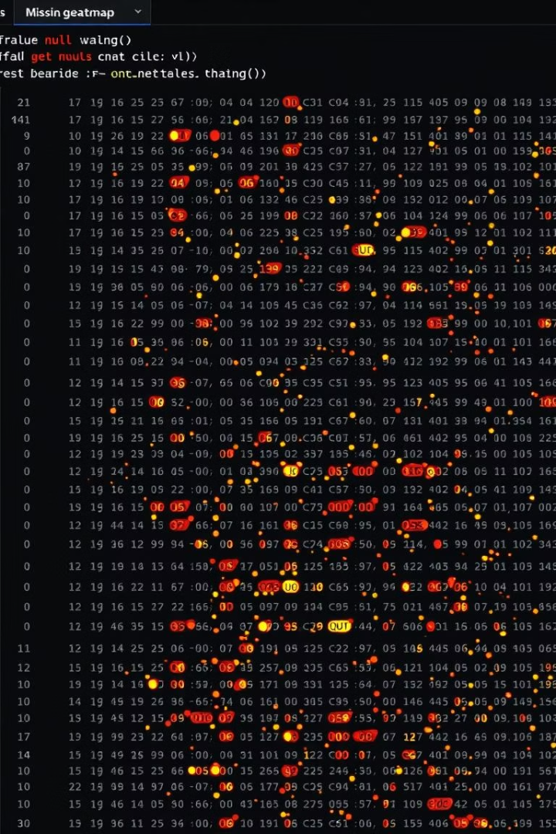


Identifying Missing Values Visually
Null Value Check
Heatmap Visualization
The data.isnull().sum() command precisely identifies missing entries per column.
A heatmap using Seaborn offers a clear visual representation of where null values exist in the dataset.
Date 0
State 181
Region 0
Confirmed 0
Deaths 0
Recovered 0
dtype: int64
import seaborn as sns
import matplotlib.pyplot as plt
sns.heatmap(data.isnull())
plt.show()

Slide 5
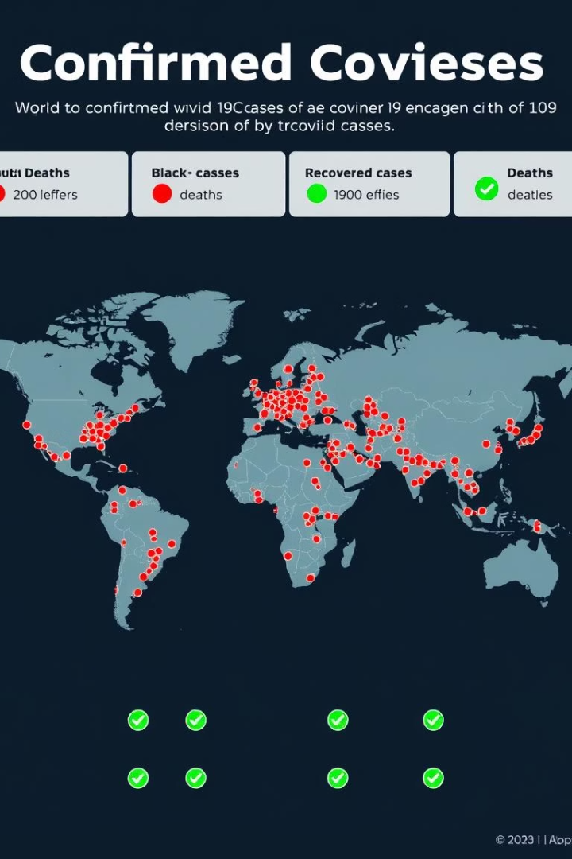
Analyzing Regional Case Statistics
1.04M
236K
US Confirmed
Spain Confirmed
The United States reported the highest confirmed cases with over 1 million.
Spain ranked second globally in confirmed cases.
133K
Spain Recovered
Spain also had the highest number of recovered cases.
By grouping the data by 'Region' and summing cases, we can identify regional trends. This helps pinpoint areas most affected by the pandemic.
US
1039909
60967
0
Spain
236899
24275
132929
Italy
203591
27682
71252
France
166543
24087
48228
UK
166441
26166
817

Slide 6
Filtering Data: Confirmed Cases Above 10
Identify Low Cases
1
We first identify records where confirmed cases are less than 10.
Apply Filter
2
Using boolean indexing, we remove these minor entries from the dataset.
Refine Dataset
3
This streamlines our analysis, focusing on more significant outbreaks.
Removing records with very few confirmed cases helps focus our analysis on more impactful data. This is crucial for larger datasets like the original 19,000 rows.
data = data[~(data.Confirmed < 10)]

Slide 7




Sorting Data for Deeper Insights
Descending Recovered Cases
Ascending Confirmed Cases
Sorting by confirmed cases in ascending order reveals regions with minimal impact. This helps understand initial spread or containment efforts.
Sorting by recovered cases in descending order highlights regions with successful recovery rates. This points to effective healthcare responses.
Sorting the data provides quick insights into extremes. This helps in identifying best practices in recovery or understanding early infection patterns.

Slide 8




Key Takeaways and Next Steps
Data Cleaning Mastery
Exploratory Analysis
Practical Application
You've seen how to identify and handle missing values effectively.
Basic aggregation and sorting revealed critical regional differences.
These skills are fundamental for any real-world data science project.
Today, we've covered essential data analysis steps using Python and Pandas. The next step is to apply these techniques to the full 19,000-row dataset. This will solidify your practical data science skills.

